Slide 1
The Effect of Drug Abuse on Mental Health
Raj Singh

Slide 2

The Problem Statement
Don’t know how exactly drug abuse is related to development of mental illness, especially amongst adolescents
Want to closely investigate what drugs lead to psychological distress

Slide 3


The Data
Dataset from Substance Abuse and Mental Health Services Administration
Various features involving drug abuse
Predictors include severe psychological distress, major depression, etc.

Slide 4
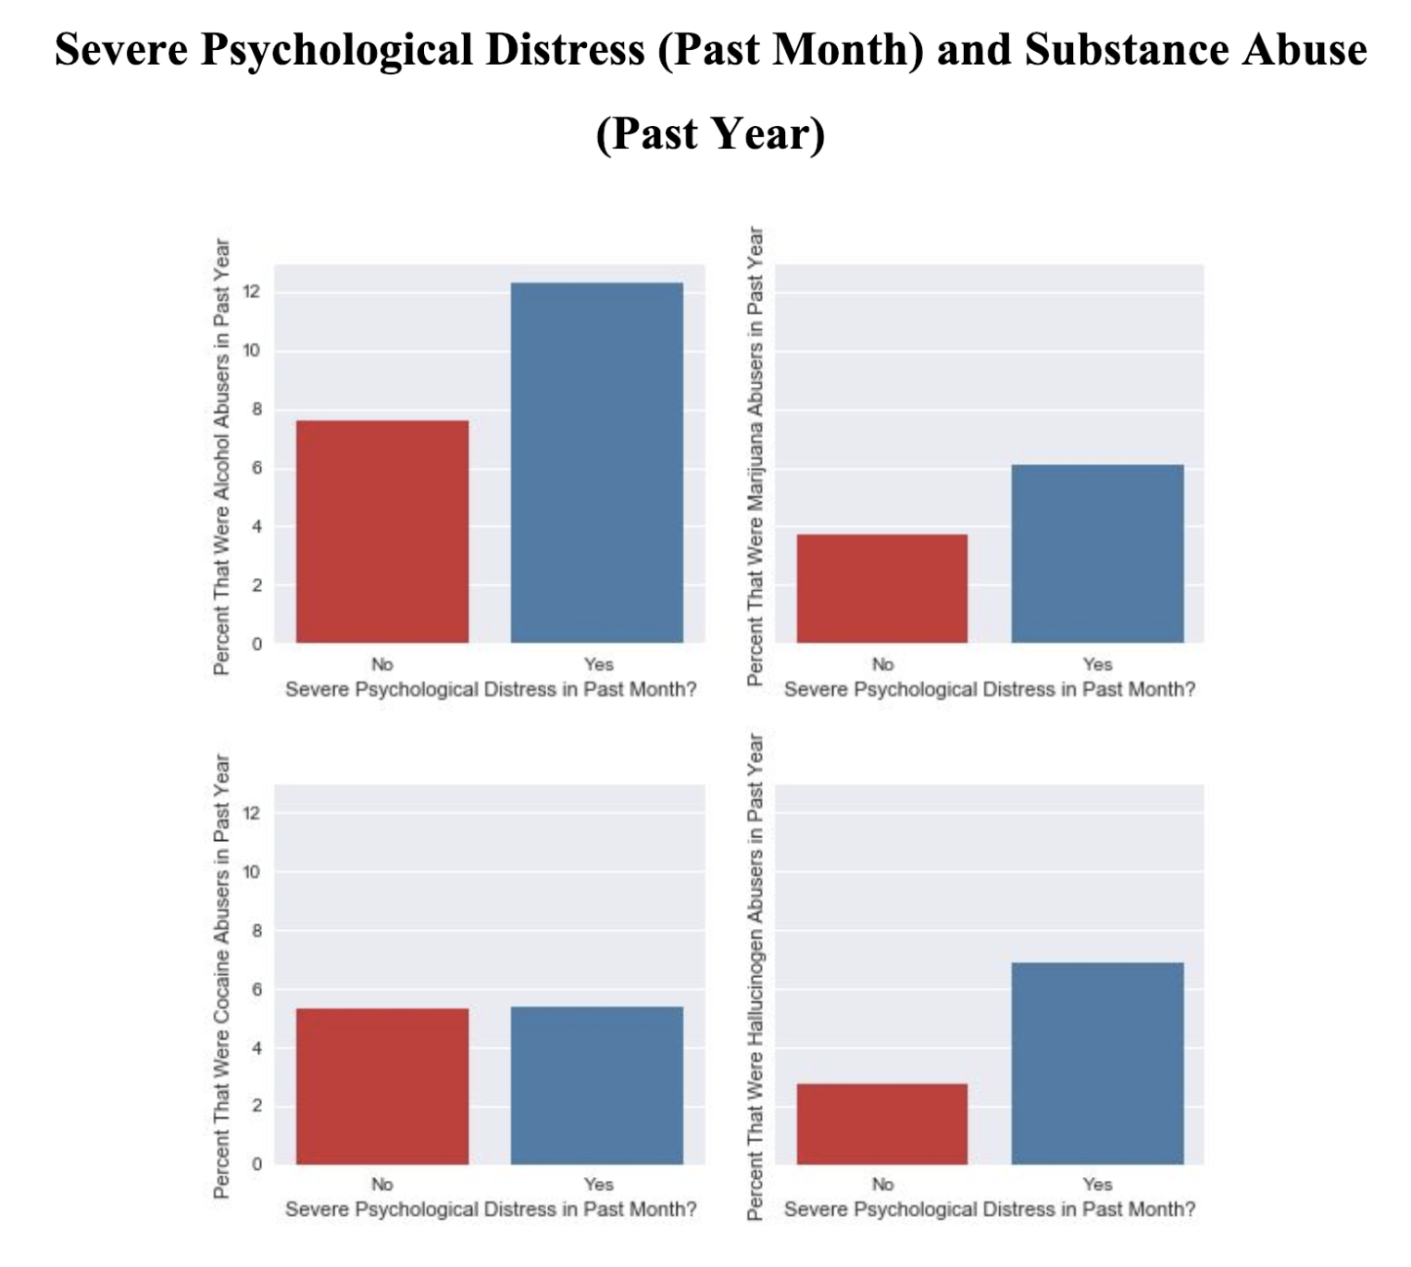
Initial Exploratory Steps

Slide 5
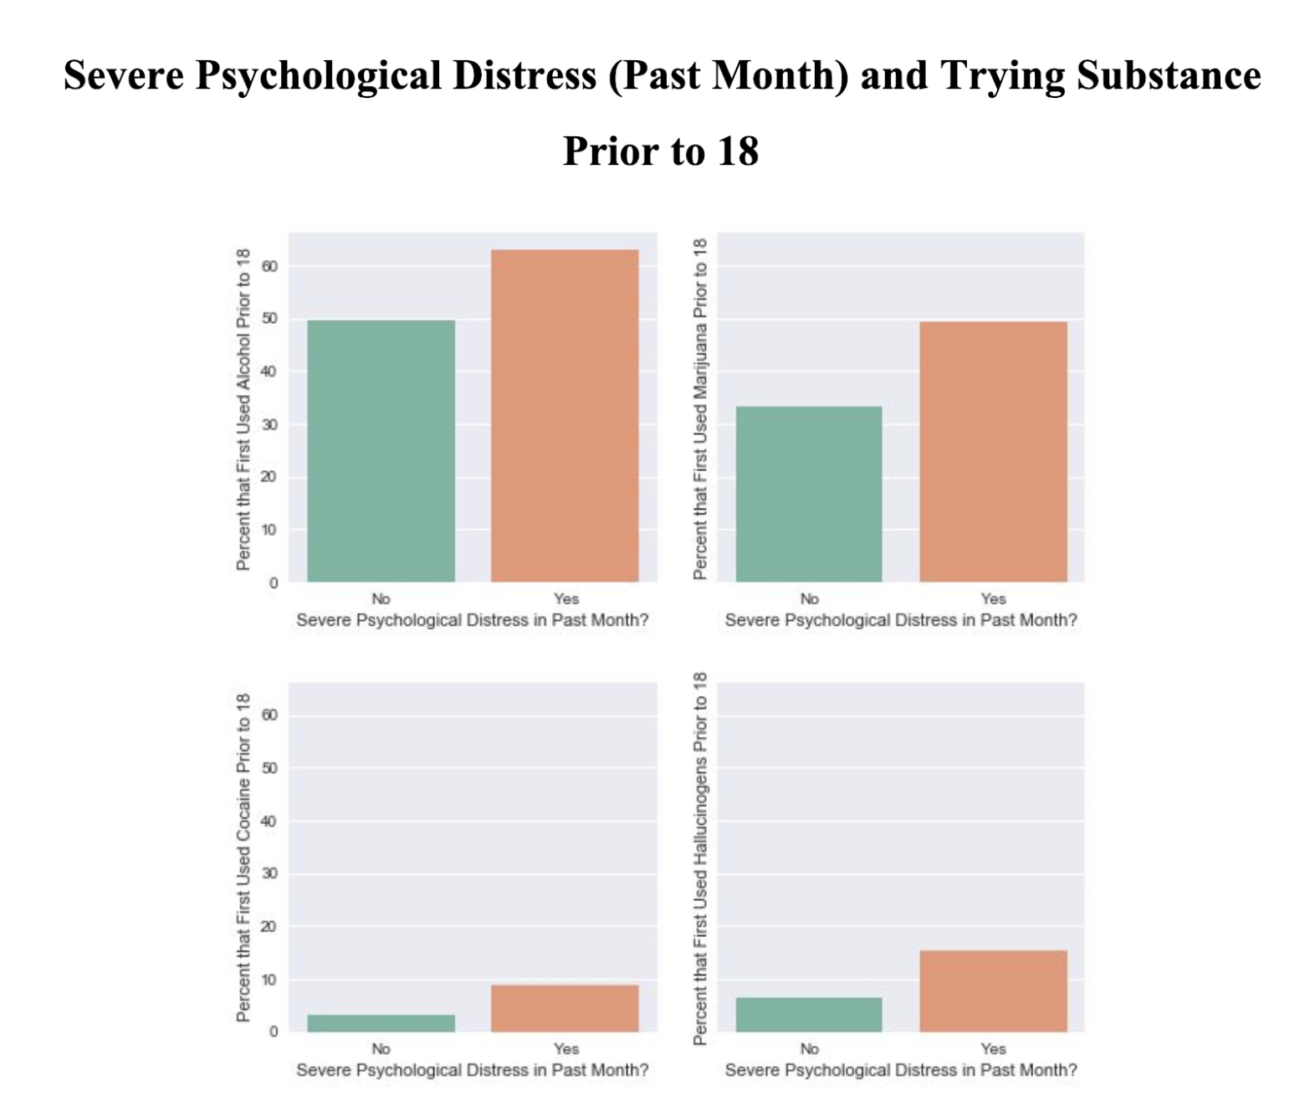

Slide 6
Conclusion from EDA
Two-sample proportion t-tests yield statistical significant results at the alpha = 0.01 level (see report for more info)
There is definitely some link between drug abuse and mental health!

Slide 7
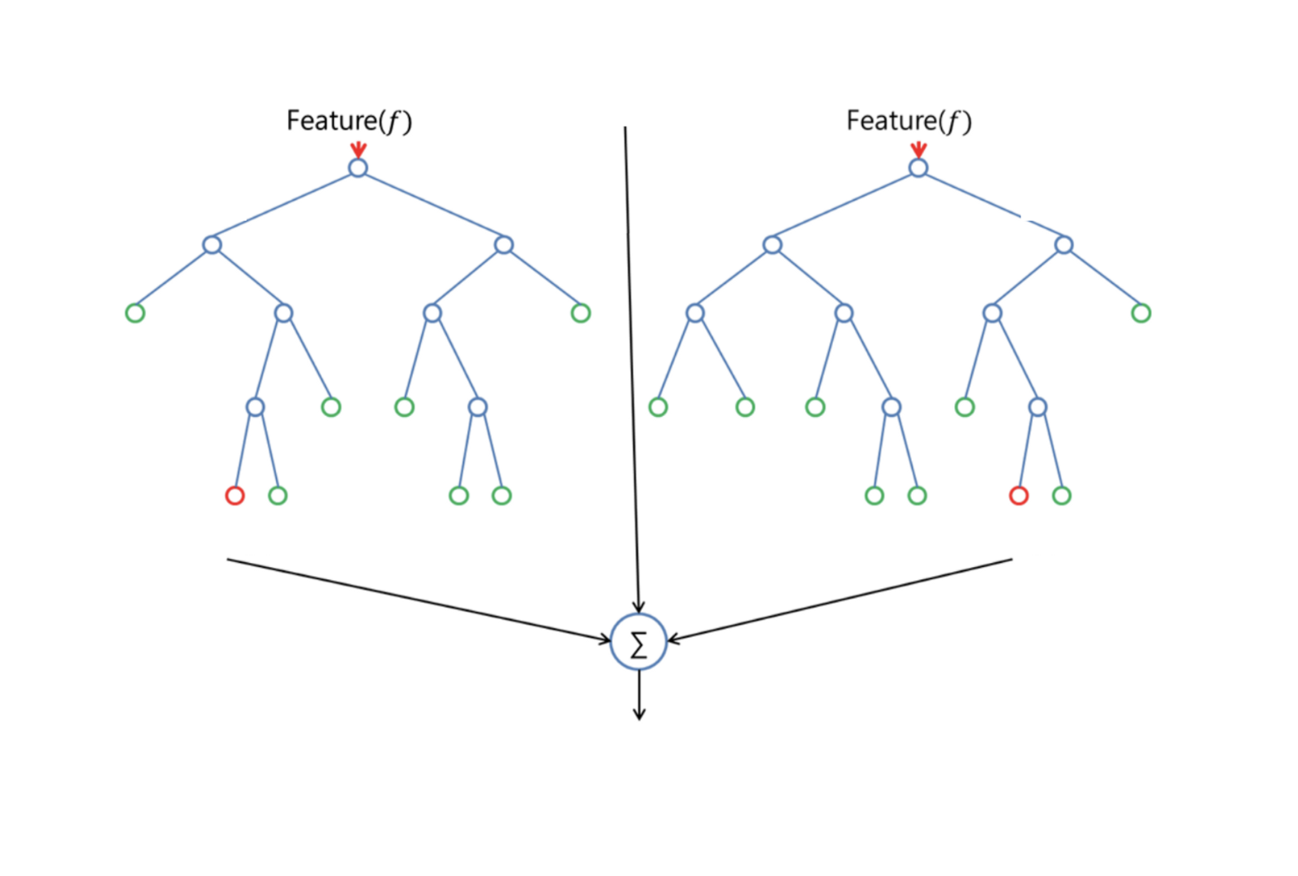
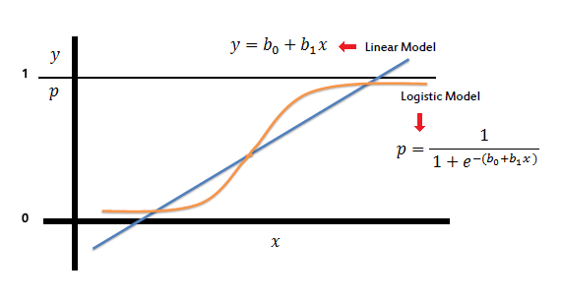
Modeling
Predicting whether or not an individual experienced severe psychological distress in the past month
Several different approaches were tried
Logistic Regression
Random Forest
Adaptive Boosting
Gradient Boosting

Slide 8
Best Results - Logistic Regression with Balanced Class weights
Balanced class weights are applied to fix the “imbalanced class” problem
There are more people who are not severely psychologically distressed (ratio is about 9:1)

Slide 9
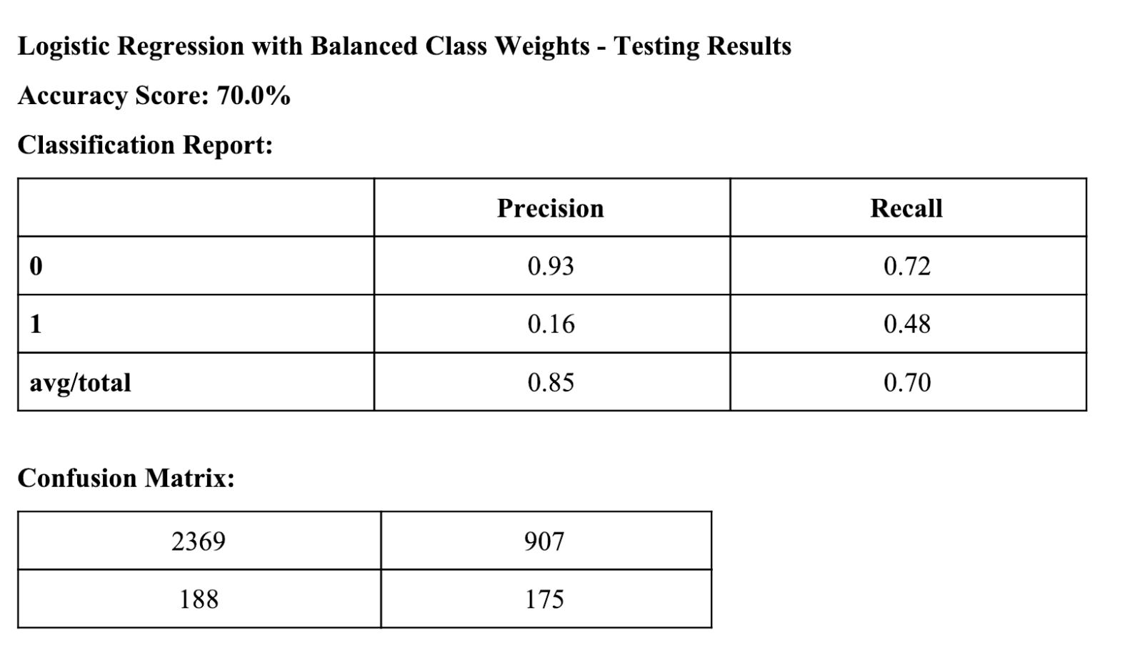
Results

Slide 10
Conclusion/Additional improvements
There is certainly a moderately strong relationship between drug abuse and mental health
More feature engineering needs to be done
Might achieve a better accuracy by singling out features that are more predictive of severe psychological distress
Recommend using logistic regression, other algorithms achieved similar results with slower training times

Slide 11
Works Cited
https://www.uspm.com/understanding-drug-abuse-and-addiction/
https://obssr.od.nih.gov/understanding-the-cross-national-disparity-in-depression-a-comparison-of-china-and-russia/
https://www.hiv.gov/blog/samhsa-funding-opportunity-integrate-mental-health-substance-abuse-disorder-treatment-hiv
https://towardsdatascience.com/the-random-forest-algorithm-d457d499ffcd

